Slide 1
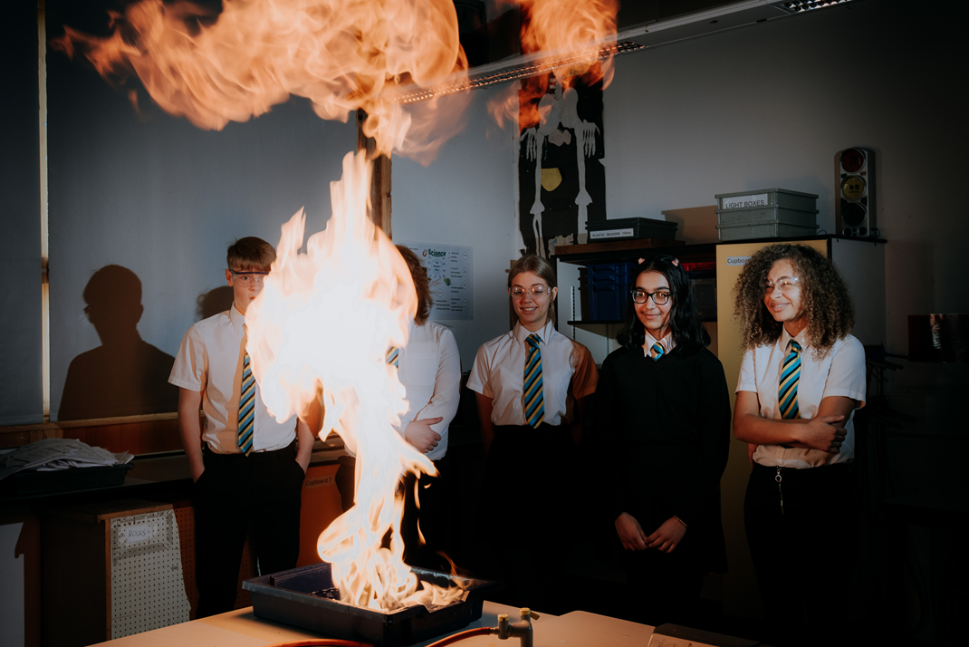
Welcome all to Year 7 Induction Evening 2023
“Leaders work hard to ensure the smooth transition of pupils into Year 7. Pupils say they settle in well and parents agree” OFSTED

Slide 2
Welcome
Headteacher - Mr M Wilson
Head of School - Mr C Conlon
Deputy Headteachers
Mrs A Pollon
Ms N Hartshorne
Key Year 7 Staff
Assistant Headteacher - Mr C Tongue
Head of Year – Mrs C Bentley
Teacher in charge of liaison – Mrs K Parbery
SENDCo - Mr S Paul

Slide 3
Who Are We? Wigston Academies Trust
Wigston Academy
An 11 – 16
‘This is a good school that serves its community well. Teachers have high expectations of what all pupils can achieve’ OFSTED 2022
Wigston College
Sixth Form College
‘Students come first in this happy and caring community. Students feel well looked after by staff who know them well. Students know staff are there when they need them’ OFSTED 2022
‘Our students and staff are our school.’
Headteacher – Mr Mike Wilson

Slide 4
Year 7 student comments
I was really scared/nervous to move from my old school to Wigston Academy, now I’m not nervous at all. I’ve made so many friends and all the teachers are so nice and understanding and will help you with anything you need.
I feel like I have been fully prepared and know everything I need to know because of the induction days. I have really enjoyed my first two weeks at Wigston Academy. The teachers have helped a lot and have reassured me when I didn’t understand something.
I feel great about the transition and first 2 weeks at secondary school. I feel like in the boot camp they told us everything we needed to know about Wigston Academy. I really like the school.
I really enjoyed my induction at Wigston Academy! On my first day I already felt like I was fitting in. The support from the staff and my tutor helped a lot.
It was fun and enjoyable. I didn’t feel worried like when I start something new. I also have been enjoying these first 2 weeks and I would like to feel like this for the rest of Year 7.

Slide 5
Our Trust Values
Respect
Ambition
Responsibility
Engagement
Resilience
“The school’s ‘RARER’ (resilience, ambition, responsibility, engagement and respect) values are evident throughout the school and understood by pupils” OFSTED 2022

Slide 6
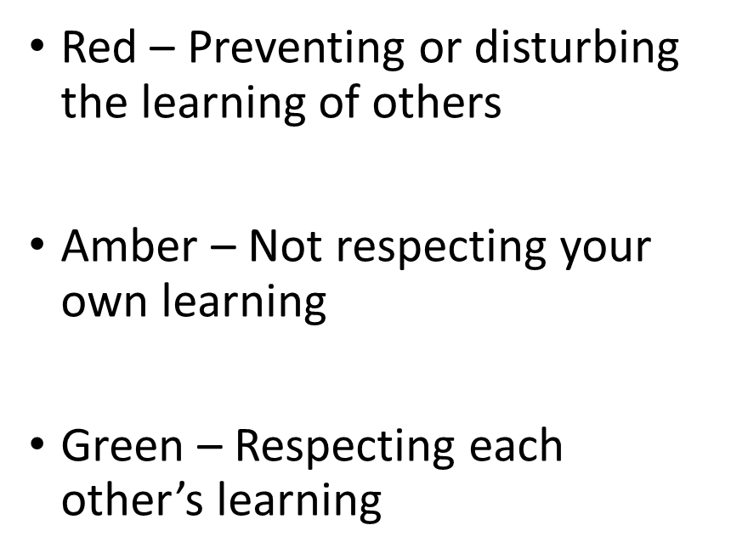
Respect Ambition Responsibility Engagement Resilience
Your own learning and the learning of others

Slide 7
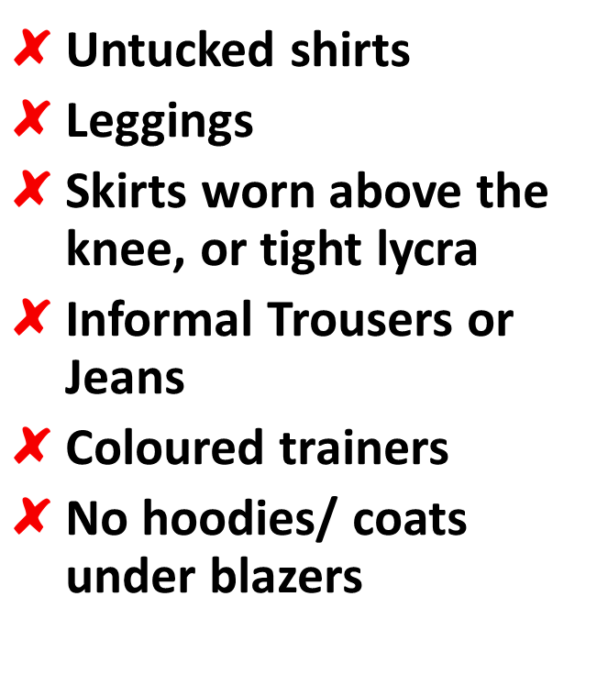
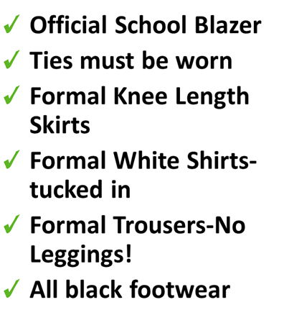
Respect Ambition Responsibility Engagement Resilience
Uniform
Most of the online shops need orders by July 31st.
“There are positive relationships between staff and pupils” Ofsted 2022

Slide 8
Respect – wear it with pride
Respect Ambition Responsibility Engagement Resilience
On days when you have PE, you will come to school in your PE uniform and stay in kit all day.
Don’t forget to label all of your clothing items
If you are injured/ill and cannot take part in the lesson, you still come to school in PE kit but you MUST have a letter from home excusing you.

Slide 9
Respect – wear it with pride
Respect Ambition Responsibility Engagement Resilience
Students must wear Wigston Academy PE kit on the days you have PE lessons.
Students will be expected to wear plain black tracksuit bottoms, sports leggings or shorts (standard fit shorts or cycling shorts that are a minimum of mid-thigh length) All PE bottoms such as jogging bottoms or shorts must be plain black, white Adidas stripes etc. are not allowed if they do not want to wear the school branded bottoms. For safety, students need to wear appropriate trainers and not canvas shoes such as converse which have no support for PE practical lessons.

Slide 10
Respect Ambition Responsibility Engagement Resilience
Passport to Success – The Wigston Way
“Pupils value the range of leadership responsibilities available to them, including being on the school council, being ambassadors and being sports leaders” OFSTED 2022

Slide 11
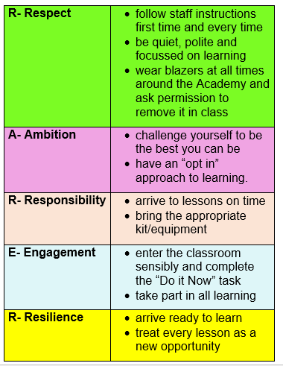
Respect Ambition Responsibility Engagement Resilience

Slide 12
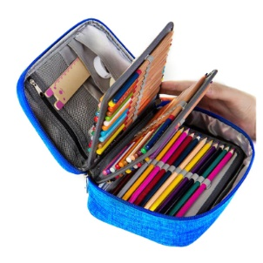
Respect Ambition Responsibility Engagement Resilience
To be have the proper equipment
What you need…
A reading book
A pencil case
A blue and black pen
A purple pen
Pencil
Ruler
Rubber
Calculator
and to carry it all:
Your school bag

Slide 13
Communication is Key
WAT
APP
WAT APP will be our only communication tool to reach parents/carers from September 2023.
There will be 3 ways that you may be contacted via WAT APP
APP Notification (same style as WhatsApp)
Email
A text message
If you need support with setting up the APP or need assistance with features in the app you can contact our support department using the email address below
What can the app do?
Report Absence
Receive messages
Newsfeed with relevant information
Calendar with important dates
See set homework
Access to SCO Pay to top up
Support Email: app@wigstonmat.org

Slide 14
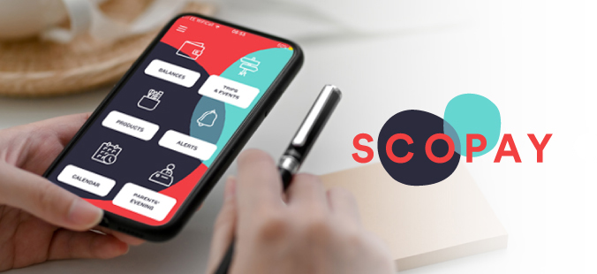
Communication is Key
Accessing ScoPay
You can access ScoPay by going to either
Wigston Academy website (links tab)
WAT APP
What do we use ScoPay for
Lunch Account Payments
Trips
Uniform
Revision guides
Any other online payments
If you need support with setting up your ScoPay account or need assistance with features in the app you can contact our support department using the email address below
Support Email: app@wigstonmat.org

Slide 15
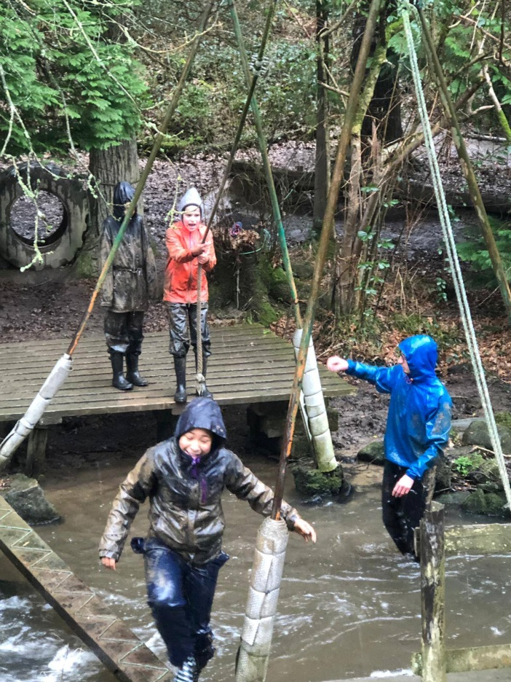
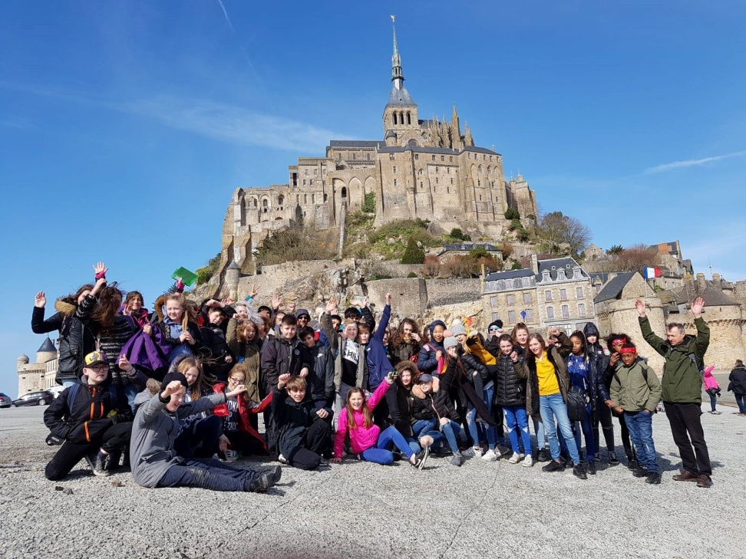
French Trip – Chateau de la Baudonniere
Where – Normandy, France
When – 17th – 22nd March 2024
Who – Year 7
Cost - £570
Deposit will be needed end of September

Slide 16
We look forward to welcoming our Year 7 students back tomorrow and also on the first day of the new term Tuesday 29th August 2023 at 8.30am
“This is a school of which the whole community can be proud” OFSTED 2022

