Slide 1
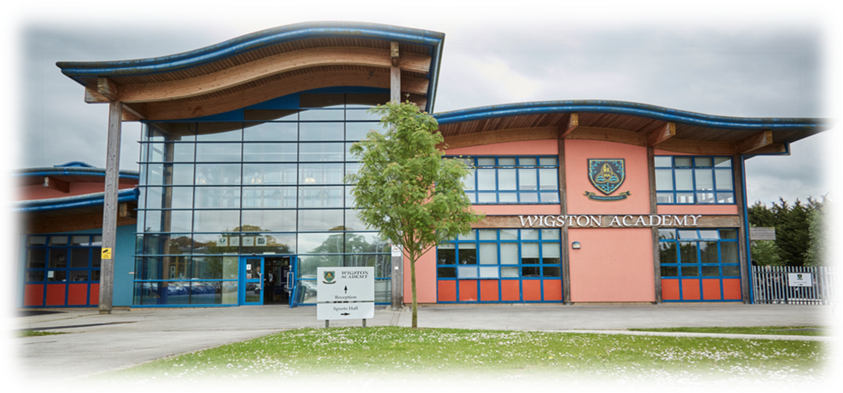

Slide 2
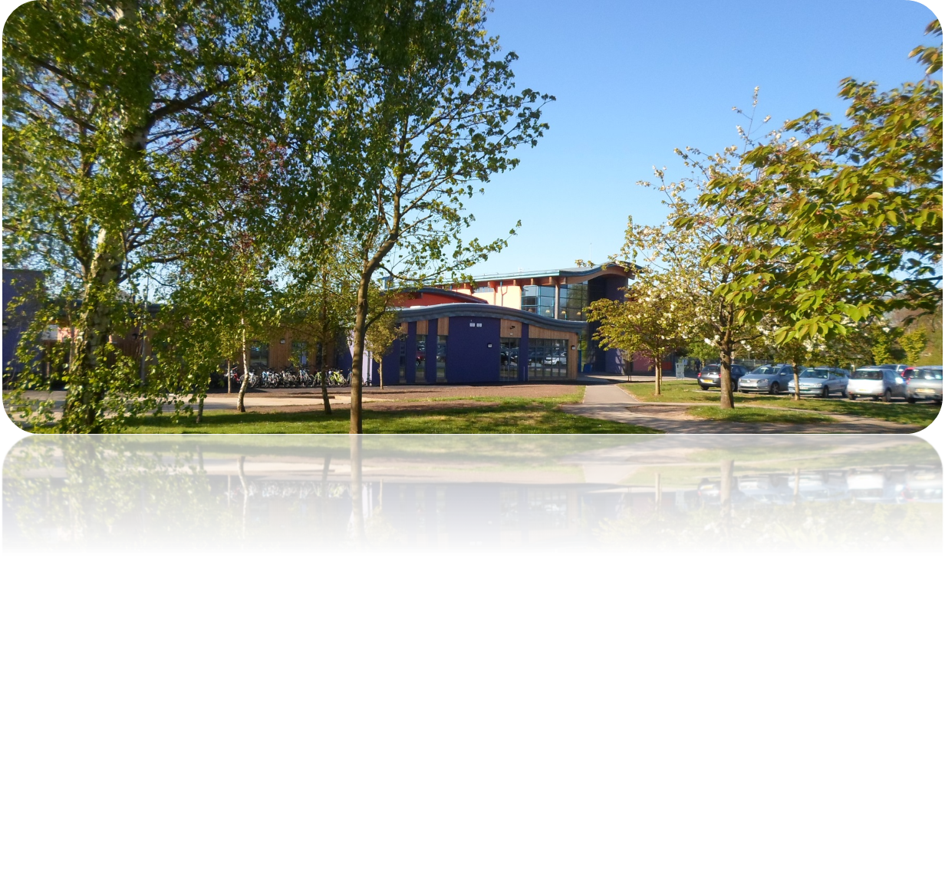
Coming to Wigston Academy

Slide 3
Welcome and Introductions
Mr M Wilson –Headteacher
Mr C Conlon – Head of School
Ms N Hartshorne – Deputy Headteacher
Mr C Tongue – Assistant HT – Pastoral (Year 7-10)
Head of Year 7 - TBC
Mrs K Parbery – Teacher, Induction & Primary Liaison
Mr S Paul – SENDCo & ERP Manager

Slide 4
This Evening
Pre-induction
Chance to meet some key staff
To tell you about us and what to expect
Key dates and events
Address concerns
Answer questions

Slide 5
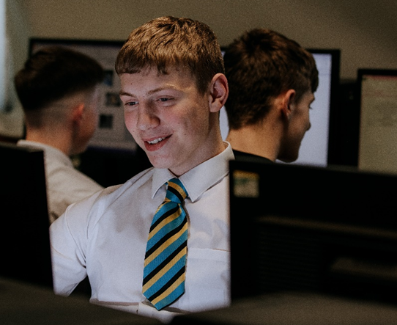
Who Are We?
Wigston Academies Trust
Wigston Academy
An 11 – 16 merged school
Wigston College
Sixth Form College
‘Our students and staff are our school.’ Headteacher – Mr M Wilson

Slide 6
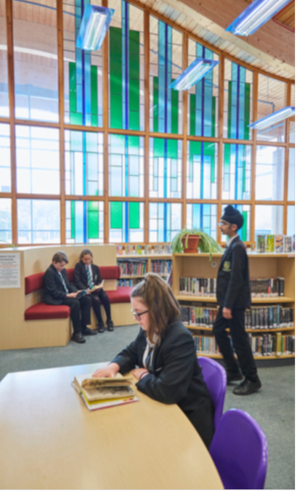
Our Values
‘The culture and morale of the school are very positive.’ Ofsted 2018

Slide 7
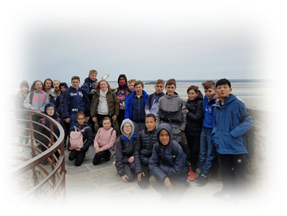
What teachers and adults say that they want Wigston Academy students to be......

Slide 8
Top Ten Worries
1. Being bullied
2. Not making friends
3. Getting lost
4. Homework
5. Not being able to do the work
6. Getting to school and back (especially if it involves a bus journey)
7. Not having the correct books and equipment
8. Not knowing what to do if there’s a problem
9. Not getting on with the teachers
10.Getting into trouble

Slide 9
The top two worries that children express are social concerns. Although common, most children report that they are no longer worried about these after just one or two weeks at school!

Slide 10
Induction and Liaison
Visits by staff to Primary feeders including assemblies and key events, parents evenings
Sports leaders to run and support Primary events
Key staff to meet Year 6 and liaise with their class teachers, including Head of Year and SENDCo
Visits to the Academy and College for events, shows and performances
Staff meetings between Primary and Academy staff

Slide 11
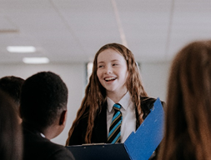
Parent – Student - Teacher
At Wigston Academy we believe that
students learn best when they are excited and engaged with their subjects, where their learning is tailored to individual needs and where expectations are high. We want our students to enjoy coming to school, where they will be supported, stretched and challenged in order to achieve their personal best.
Parent + Student + Teacher = Success

Slide 12
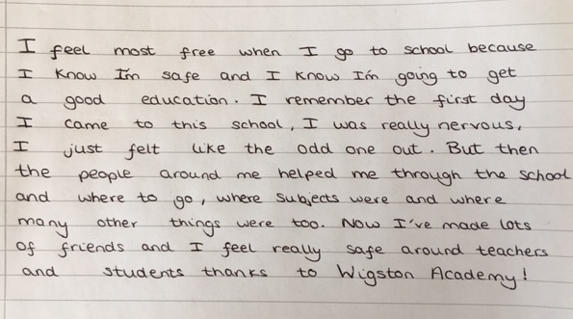
“What I feel” by a Year 7 student
‘Leaders work hard to ensure the smooth transition of pupils into Year 7 from primary schools. Pupils say that they have settled in well, and parents agreed.’ Ofsted

Slide 13
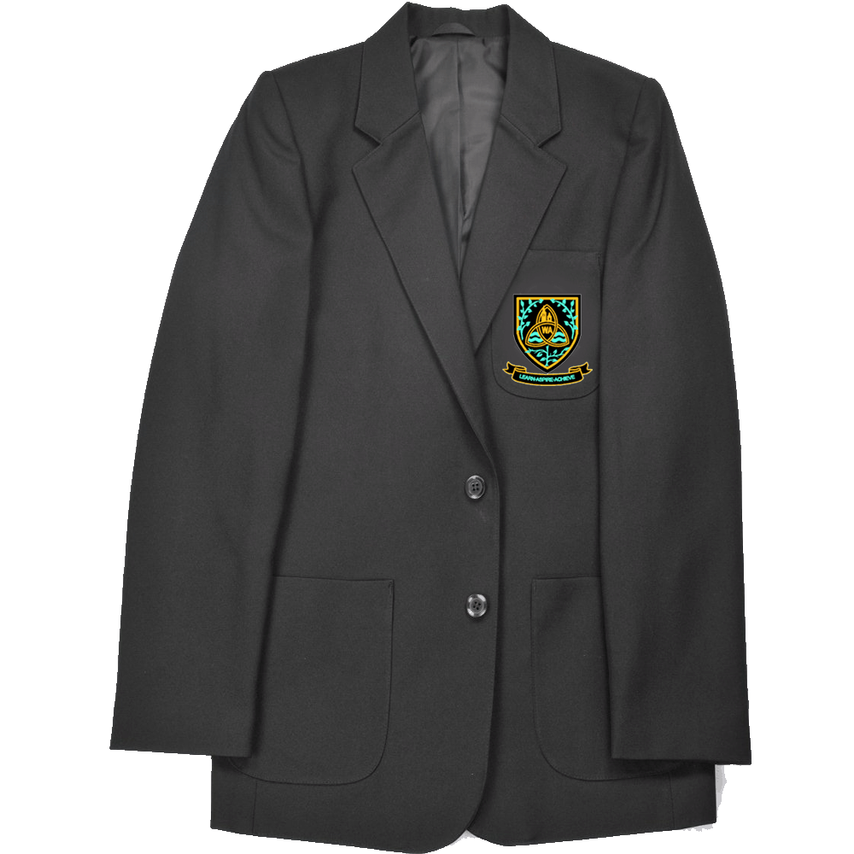
What is different?

Slide 14
Organisation
The school is divided into departments such as ‘Maths’ or ‘Science’ and all teaching staff teach in one or more of them. Most also have responsibilities for students’ well-being (their ‘pastoral’ role)
Your child will be placed in a ‘tutor group’ with other Year 7 students and their tutor will have responsibility for your child’s overall well-being
Students register in their tutor group and remain as a tutor group for most lessons (although for some subjects children may be placed in ‘sets’ according to their ability)
There are a number of pastoral staff who have overall responsibility for all of the tutor groups in their year group, including a full time non teaching Head of Year and an Assistant Head Of Year.

Slide 15
Homework
Finding and tracking your homework on our school app
Asking if you are not sure what the task means
Making sure you bring home everything you need
When you get home, organise homework
Taking your completed homework to school on the correct
day
Remembering to hand it in!

Slide 16
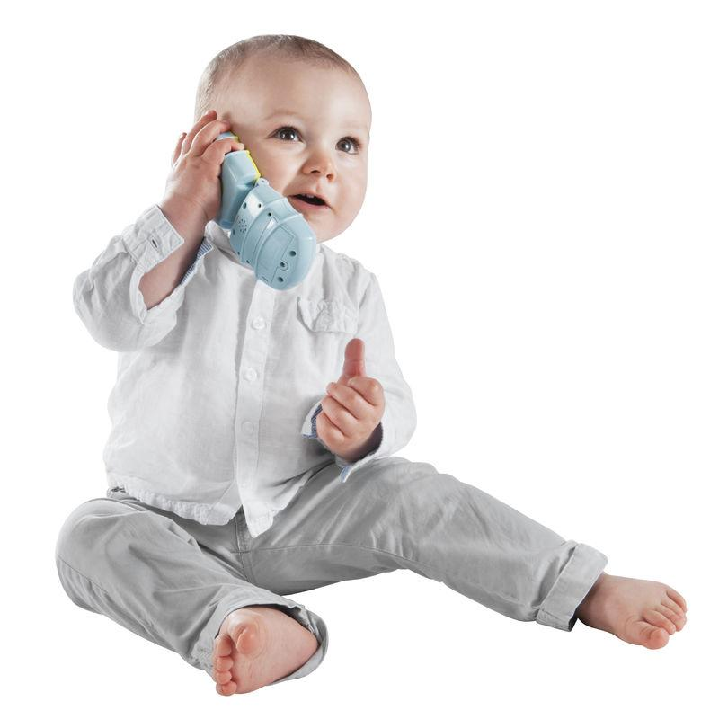
Contacting the school –
When and Who?

Slide 17
When?
You know your children best and if any aspect of school life is persistently distressing them it is probably best to err on the side of caution and intervene early. If you have talked to your child, offered reassurance, helped them come up with ways of solving the problem themselves and things still haven’t changed, then it is time to speak to the school.

Slide 18
Who?
Class Tutor – These are the people who know your child best
Individual Subject Teacher - delivers a subject area to your child
SENCO – Overall responsibility for special educational needs students
Pastoral Team – Head of Year, Assistant Head of Year
Senior Leadership Team – Mr Conlon (HoS), Ms Hartshorne (DHT) and Mr Tongue (AHT)
Contact the person who is most relevant. HOWEVER, do not worry as a message will get to the best person to deal with the issue.

Slide 19
Remember

Slide 20
What Ofsted say…..
This is a good school that serves its community well. Teachers have high expectations of what all pupils can achieve.
There are positive relationships between staff and pupils
Leaders want all pupils to be well prepared for their adult lives. Leaders have considered the local context and made sure that the curriculum addresses these needs
There is a calm and positive atmosphere around the school site.
Pupils value the range of leadership responsibilities available to them, including being on the school council, being ambassadors and being sports leaders.
Teaching provides opportunities for pupils to revisit knowledge, so that they know and remember more.
Staff care about their pupil’s education and well-being.

Slide 21
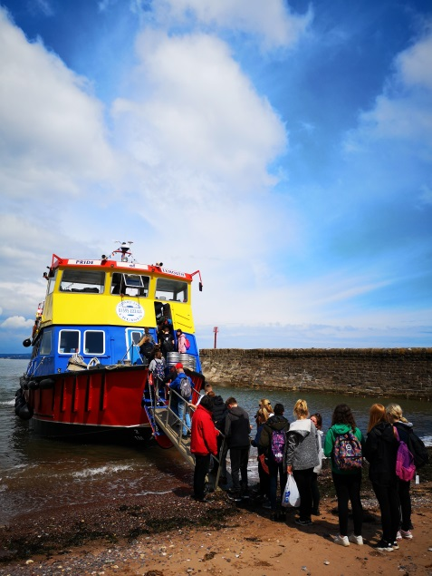
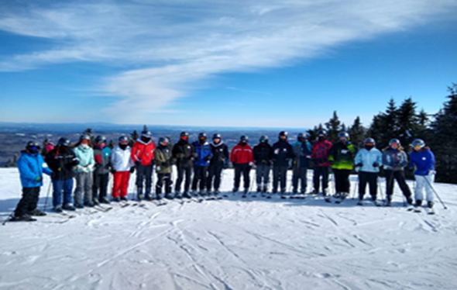
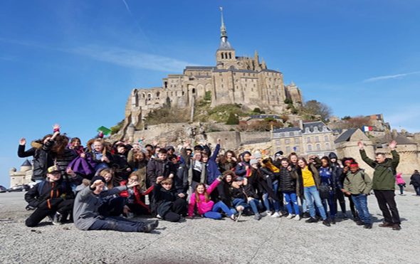
Exciting Times Ahead -Trips
During your time at the Academy there will be lots of opportunities to go on trips. In Year 7 we will be running a trip to France, more details will be shared with you soon. We also offer a camping trip to Exmouth, a ski trip to the USA in KS4 and a wide range of curricular trips.

Slide 22
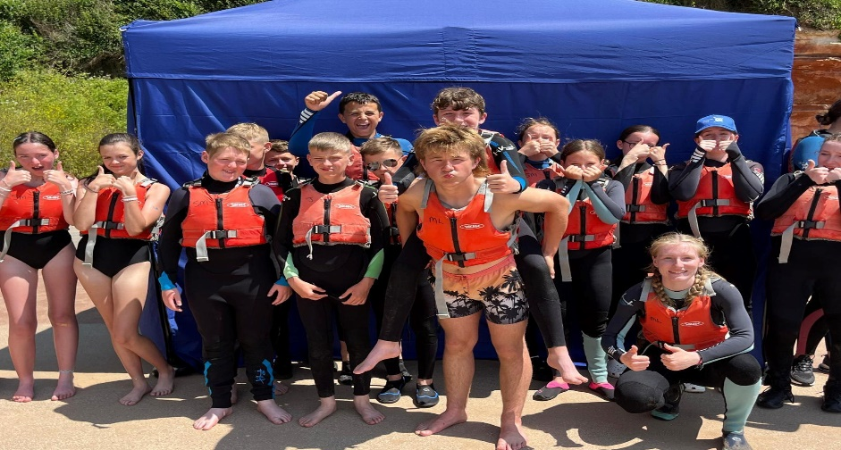
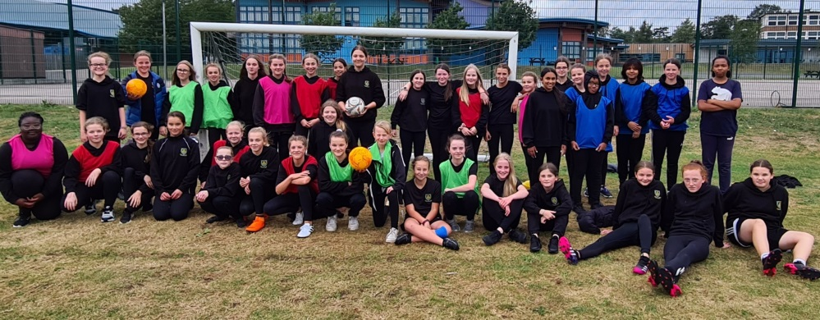
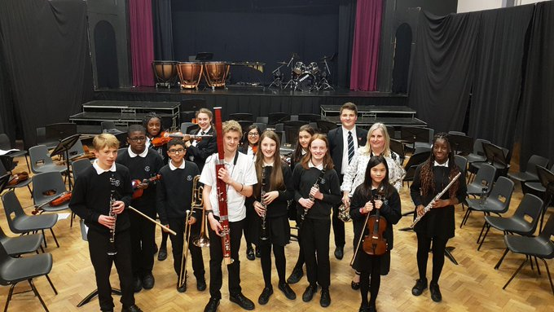
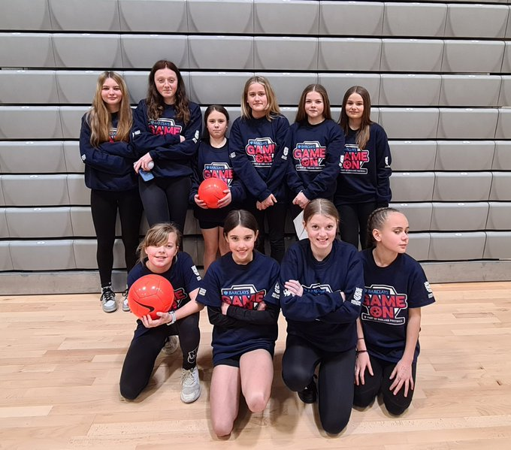
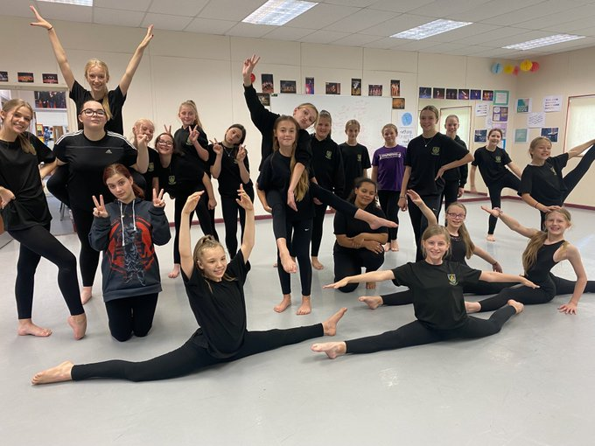
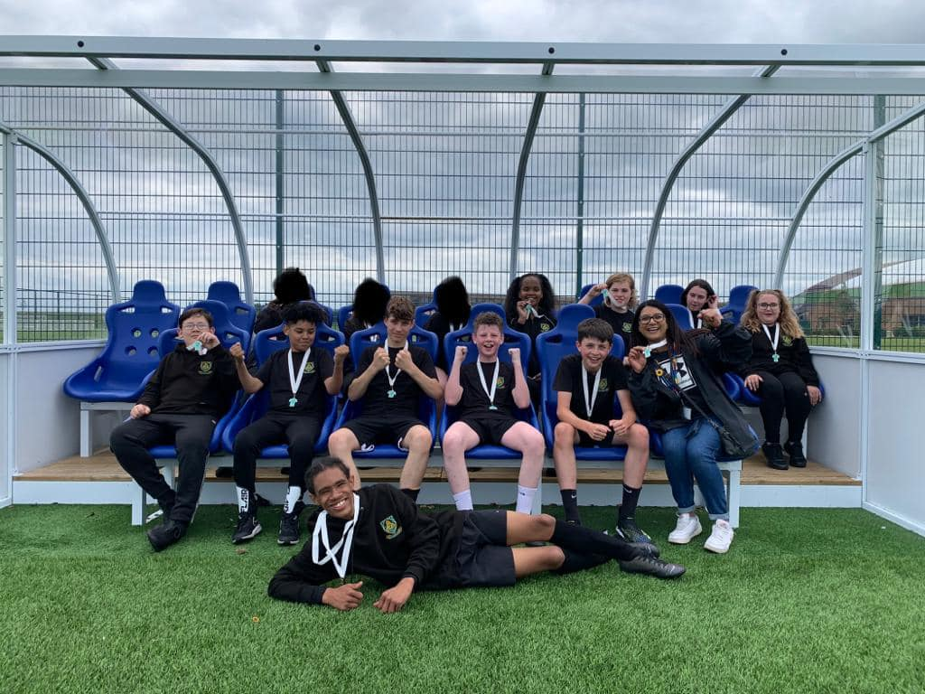
Extra-curricular activities

Slide 23
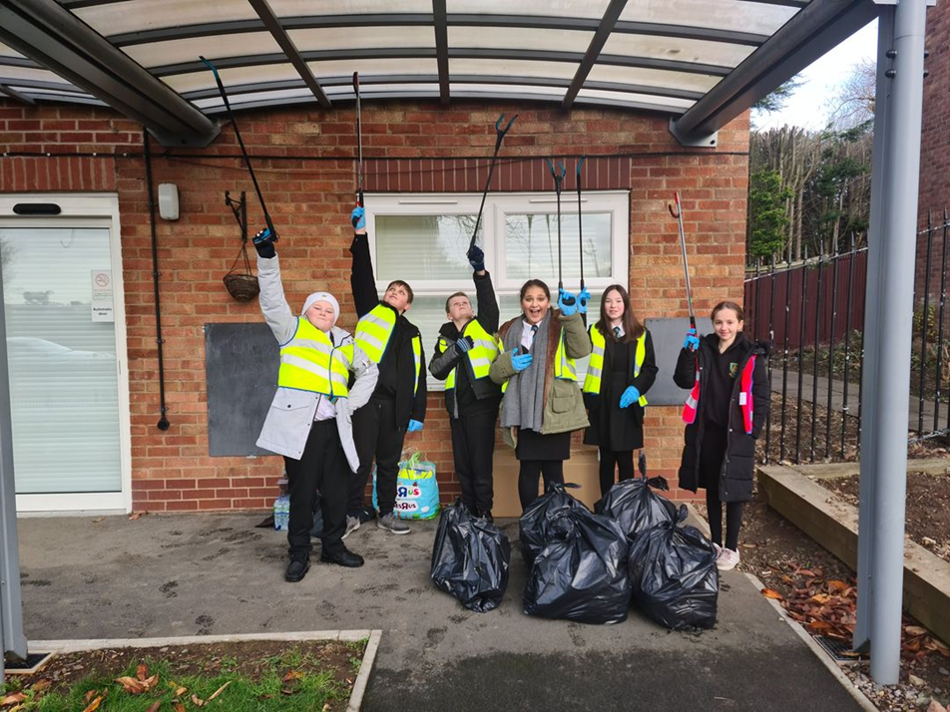
Get Involved and Do Something New community and charity events

Slide 24
What’s next?
You will receive a full induction pack which will include:
Letter from the headteacher
Student data Form
Induction Days consent form
Other important information

Slide 25
Full Induction
Monday 8th & Tuesday 9th July 2024
Two days with us to try out lessons, with a free lunch on both days, meet new teachers and make new friends.
Please follow our WA Class of 2024 facebook page for updates.
Parents Induction Evening Mon 8th July
Diary Dates

Slide 26
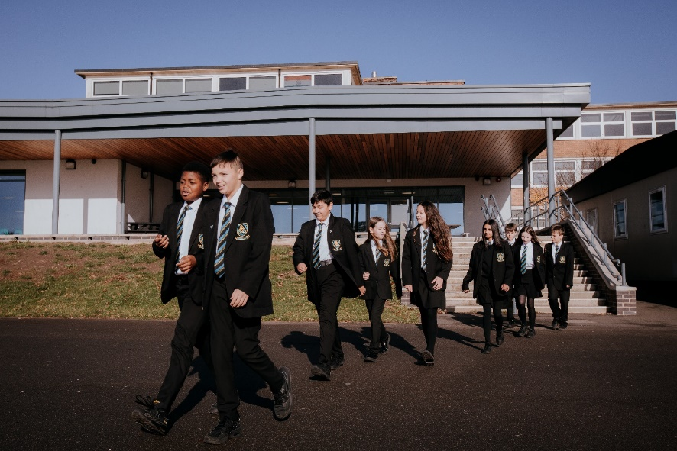
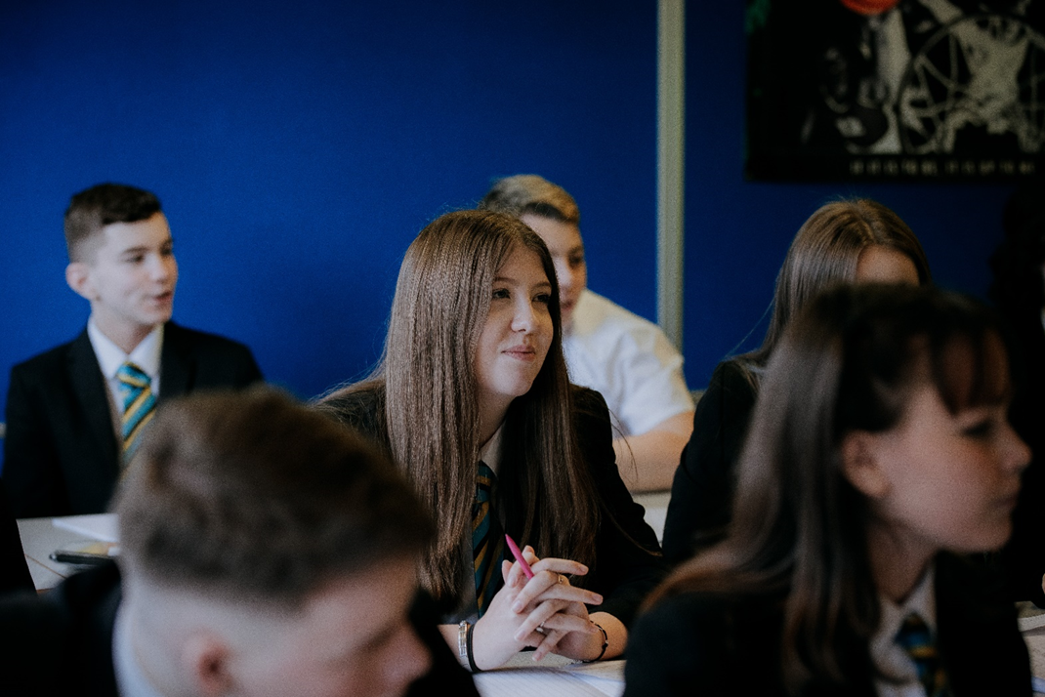
Thank you
Please feel free to ask us any questions

